Slide 1
Inspect Gas Cylinder Straps
EHS Reps or designee--Please inspect the cylinder straps in your lab when you change cylinders and when you prepare for level 2 inspections.
Replace straps if:
There is a cut/tear of any size or Fraying
Tension buckle slips
Refer to following photos of these issues

Slide 2
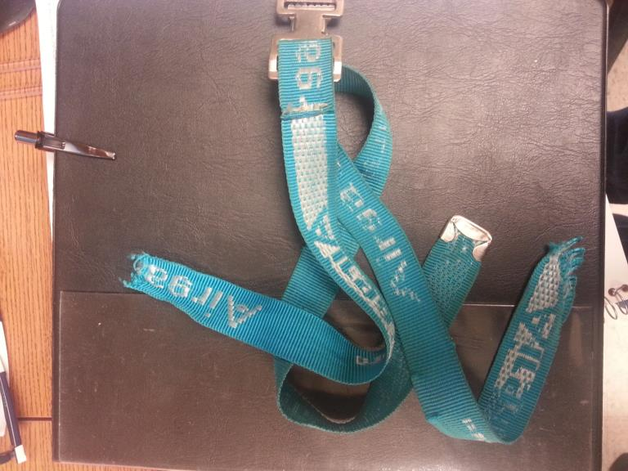
Strap in a MIT lab tore like paper during cylinder change

Slide 3
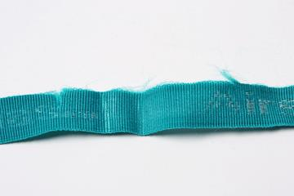
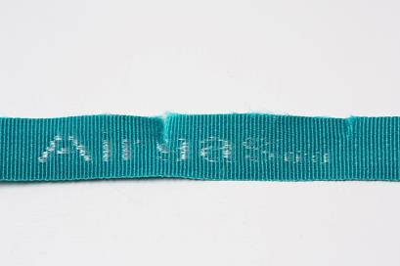
Replace strap if you find
Fraying
Cut/Tear--Any size
Excessive wear, webbing is thinning

Slide 4
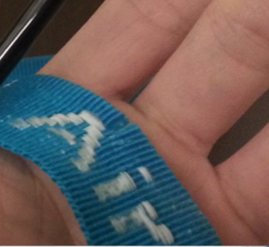
Strap with a small tear
Check straps when you change cylinders
Bend the strap, look at the edges, and run your hand along the entire strap

Slide 5
How to determine if a strap is safe
Pull the strap
if the tension spring slips, replace the strap
if the strap stays taut, strap is OK.

Slide 6
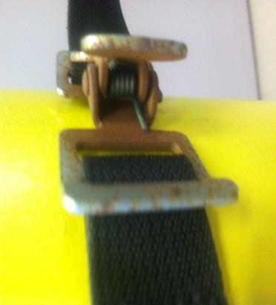
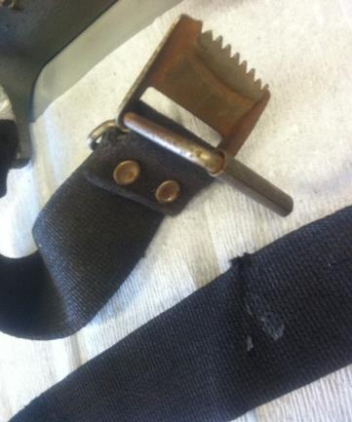
Inspect the tension spring for corrosion and loss of tension
Rusty handle/ spring is OK
Torn cotton blend belt no spring

