Slide 1
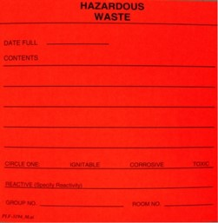
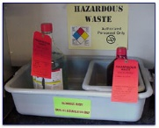
Hazardous Waste Determination
Determine
Contain & Label
If you do not know if specific waste is hazardous, check label(s) or MSDS to determine if these criteria apply:
Use only container compatible with contents
Do not mix incompatible materials
Close container.
Label container when waste is first added to it.
Fill out red Hazardous Waste label in plain English.
Ignitable
Liquids with Flash point of < 60C/140F
Solids that burn spontaneously
Flammable compressed gas
Oxidizers
Toxic
39 Contaminates listed on TCLP Table
Listed on EPA Acutely Hazardous List
Massachusetts State Listed
Waste Oil
Waste containing > 50ppm
Spell out contents:
Do not use abbreviations
Do not use formulas
List percentages for mixtures
Check off associated hazards (Check
Toxic for Toxic per TCLP, EPA Acutely Hazardous, and Mass. State Listed)
Include your location and name
Record date when container is full (must be removed within 3 Days)
Corrosive
pH <2 or > 12.5
Reactive
Unstable material
Explosive material
Water reactive material
Cyanide or sulfide-bearing waste
Accumulate
Place in designated satellite accumulation area (SAA).
Segregate incompatible waste.
Provide secondary containment.
Keep containers closed except while adding waste.
Inspect SAA weekly to ensure that the containers are closed, in good condition, and labeled
When container is filled record the date. Full hazardous waste containers must be removed to your facility’s designated <90 Day Storage Area or prepared for pickup
Dispose
To notify the EHS for Pickup, use online form:
http://ehs.mit.edu/site/content/chemical-waste-collection-form

